Slide 1
Optimization in Transport and Logistics – RaceTrack Construction Heuristic
Janick Böhm

Slide 2
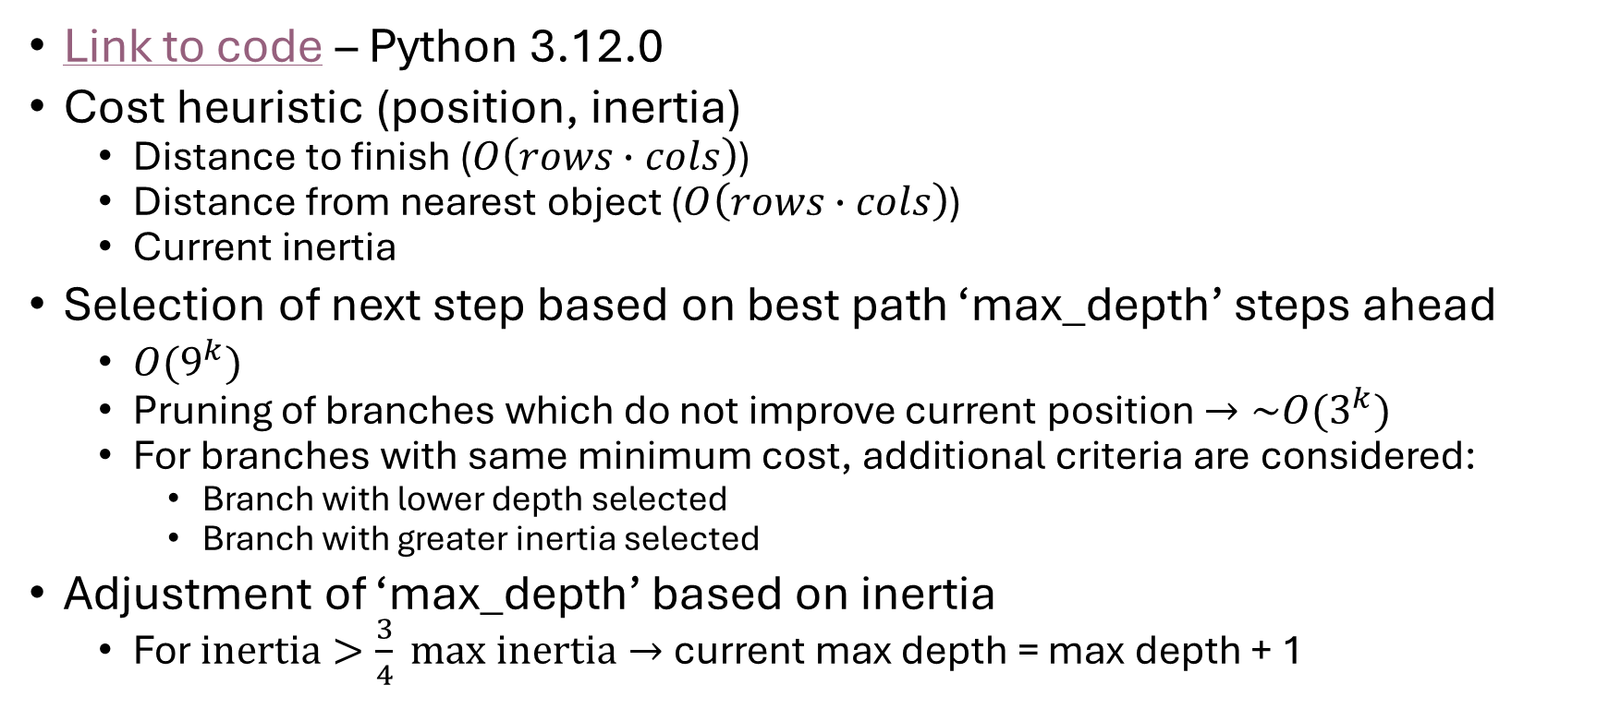
General Approach
Link to code – Python 3.12.0
Cost heuristic (position, inertia)
Distance to finish ($O\left(rows∙cols\right)$)
Distance from nearest object ($O\left(rows∙cols\right)$)
Current inertia
Selection of next step based on best path ‘max_depth’ steps ahead
$O(9^{k})$
Pruning of branches which do not improve current position $→\sim O(3^{k})$
For branches with same minimum cost, additional criteria are considered:
Branch with lower depth selected
Branch with greater inertia selected
Adjustment of ‘max_depth’ based on inertia
For $inertia>\frac{3}{4} max inertia→$ current max depth = max depth + 1

Slide 3
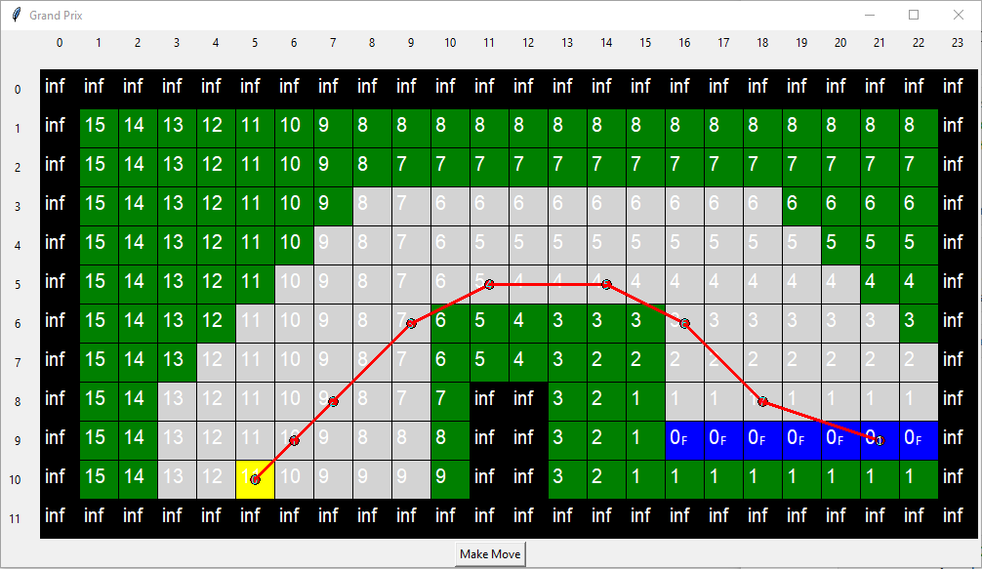
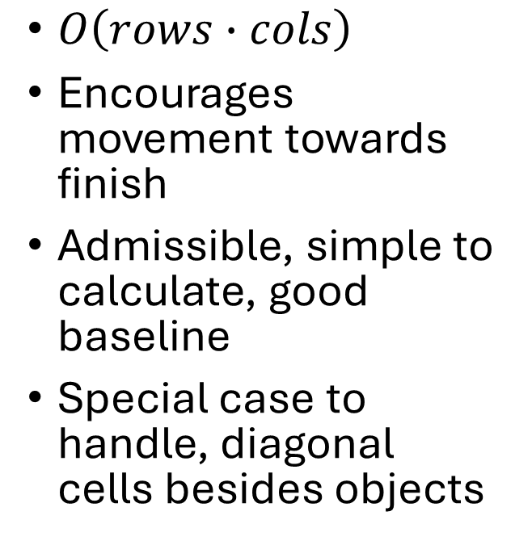
Cost heuristic – Distance to finish
$O\left(rows∙cols\right)$
Encourages movement towards finish
Admissible, simple to calculate, good baseline
Special case to handle, diagonal cells besides objects

Slide 4
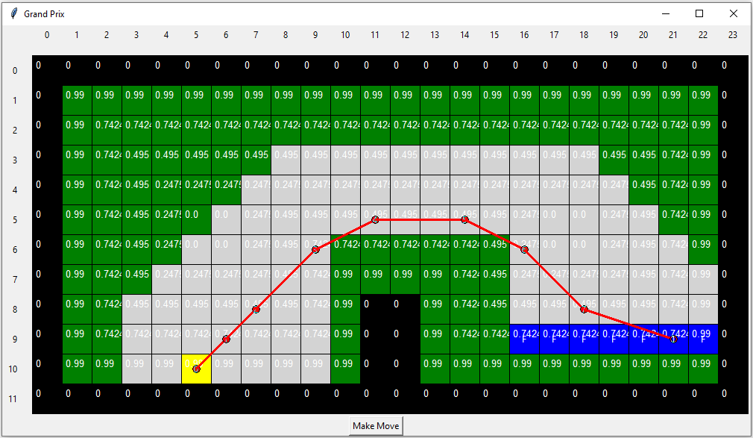
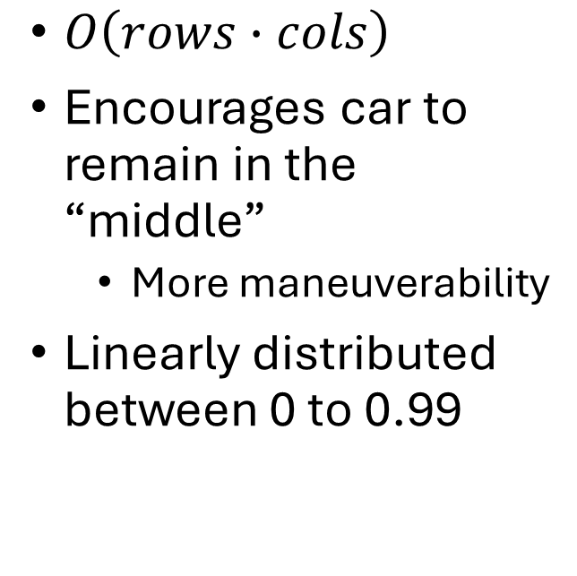
Cost heuristic – Distance from walls
$O\left(rows∙cols\right)$
Encourages car to remain in the “middle”
More maneuverability
Linearly distributed between 0 to 0.99

Slide 5
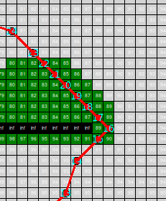
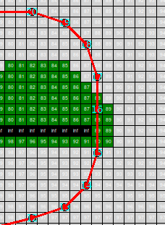
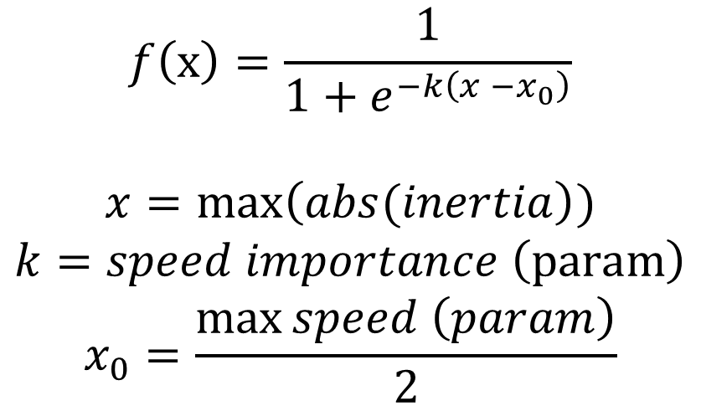
Cost heuristic – Inertia
$$f\left(x\right)=\frac{1}{1+e^{−k\left(x −x_{0}\right)}}$$
$$x=\max\left(abs(inertia\right))$$
$$k=speed importance \left(param\right)$$
$$x_{0}=\frac{\max{speed \left(param\right)}}{2}$$
Encourages car to pursue states with worse position cost, but better inertia
Logistic function
Example of path with low speed importance (large k)
Example of path with high speed importance (small k)

Slide 6
Complete heuristic function
$$h\left(pos. inertia\right)=distanceToFinish\left(pos\right)+distanceToObject\left(pos\right)−f(max⁡(abs(inertia)))$$
All parameters
max_depth (Maximum search depth when evaluating future positions)
strategy (Heuristic approach)
max_speed (Maximum allowed component of inertia)
speed_importance (Steepness of logistic function)
always_moving (Whether to allow car to stop (to reset inertia vector))

Slide 7
Results
Track no. | Max_depth | Strategy | Max_speed | Speed_importance | Steps | Runtime [s] (average, 5 runs)
1 | 3 | F | 5 | 1 | 8 | 0.06
2 | 4 | FO | 5 | 1 | 14 | 0.30
3 | 4 | FOS | 8 | 100 | 42 | 8.89
4 | 5 | FOS | 8 | 1 | 41 | 31.50
5 | 5 | FOS | 7 | 1 | 91 | 25.13
6 | 5 | F | 7 | 1 | 91 | 24.92
7 | 4 | FOS | 8 | 1 | 35 | 5.44
8 | 5 | F | 8 | 1 | 36 | 10.52
9 | 4 | FOS | 8 | 1 | 35 | 5.02
10 | 3 | FOS | 8 | 1 | 26 | 2.73
Specs:
Intel Core i7-1065G7 @ 1.30GHz [8 336 cpubenchmark.net]
16 GB RAM
Strategy Legend:
F – distance to finish
O – distance from object
S – inertia (speed) importance

Slide 8
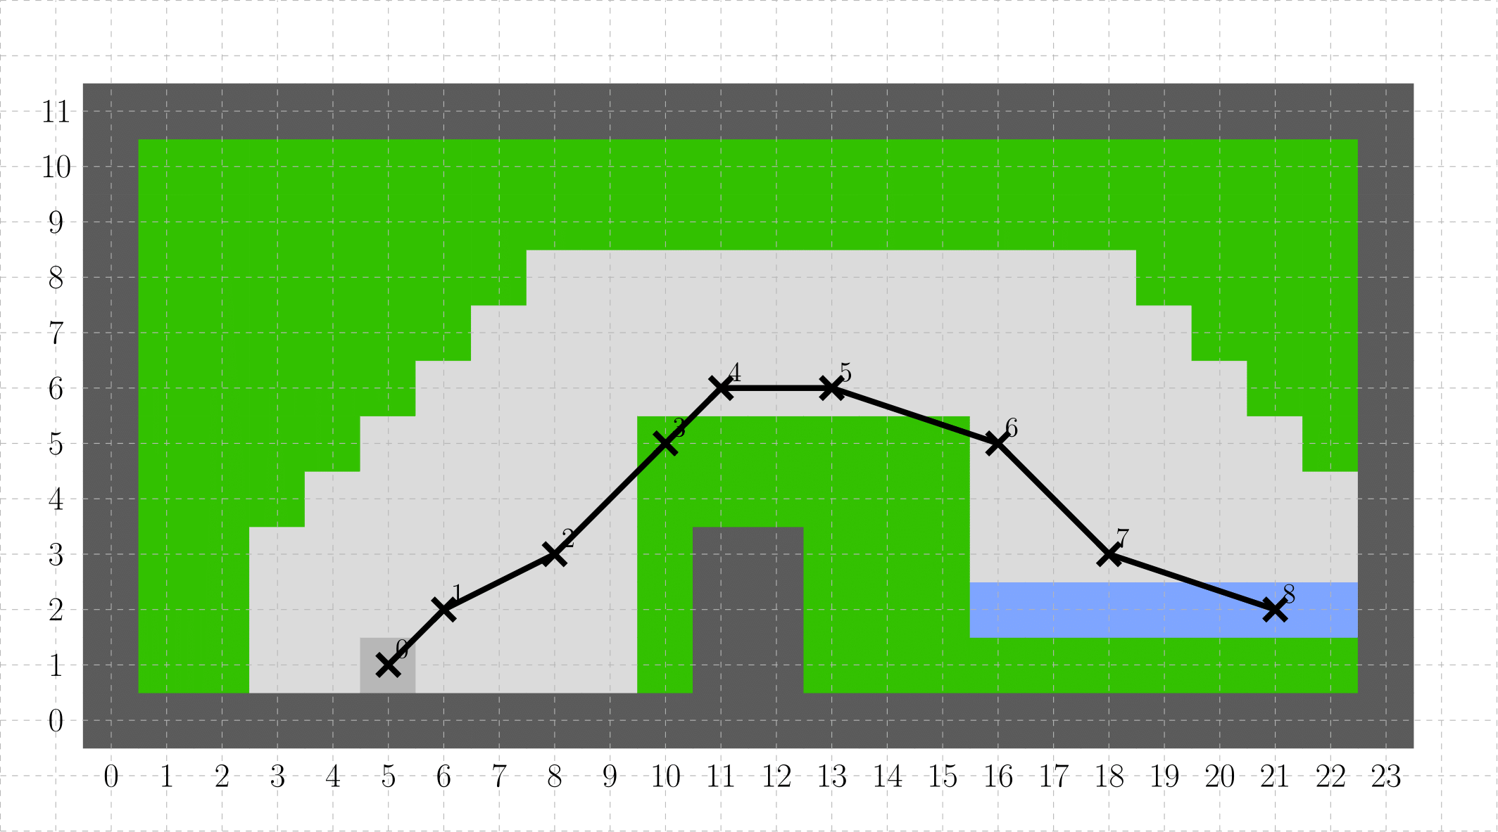
Track 1
Steps | Runtime [s] (average, 5 runs)
8 | 0.06

Slide 9
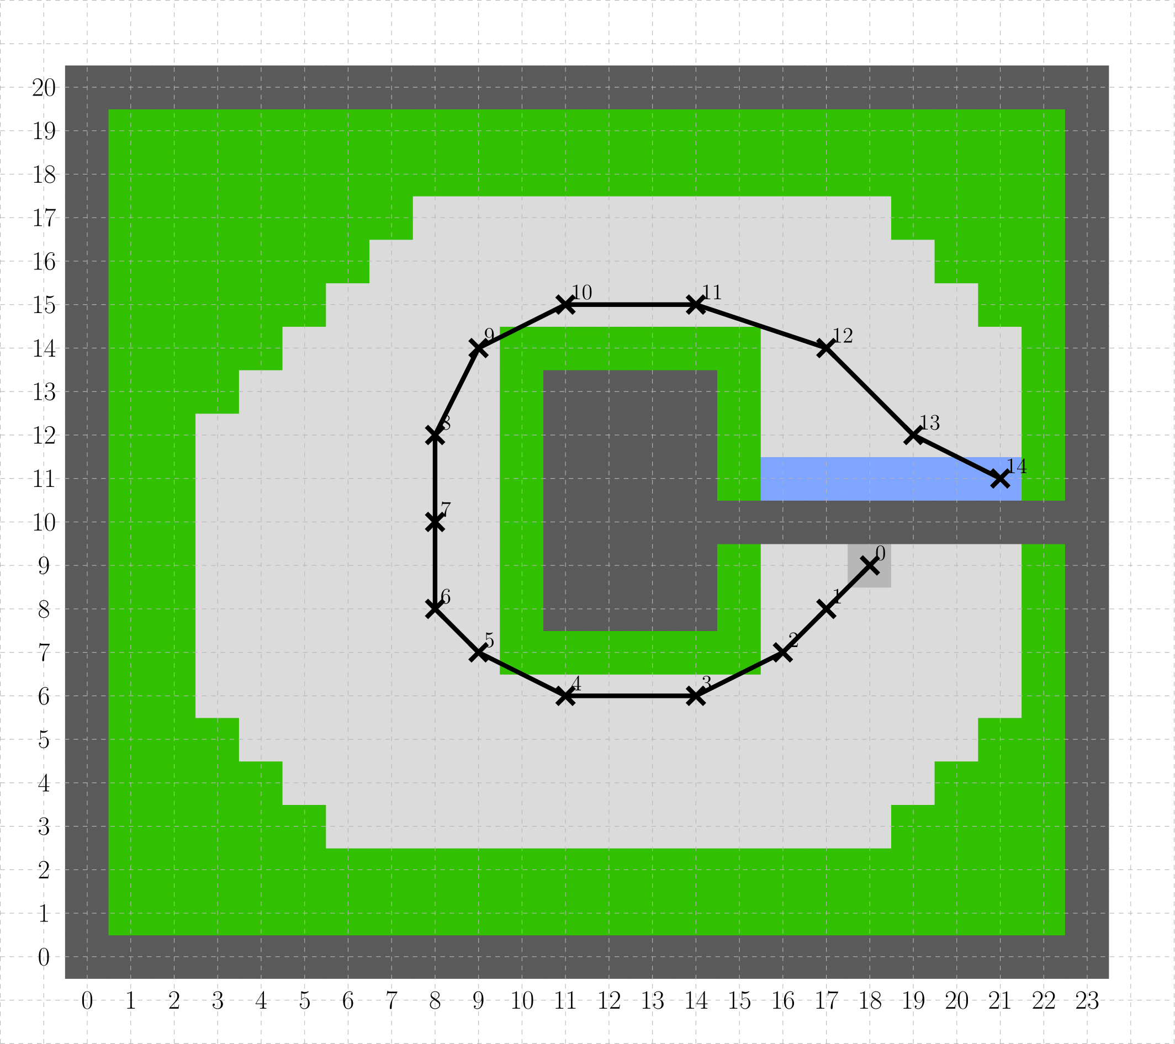
Track 2
Steps | Runtime [s] (average, 5 runs)
14 | 0.30

Slide 10
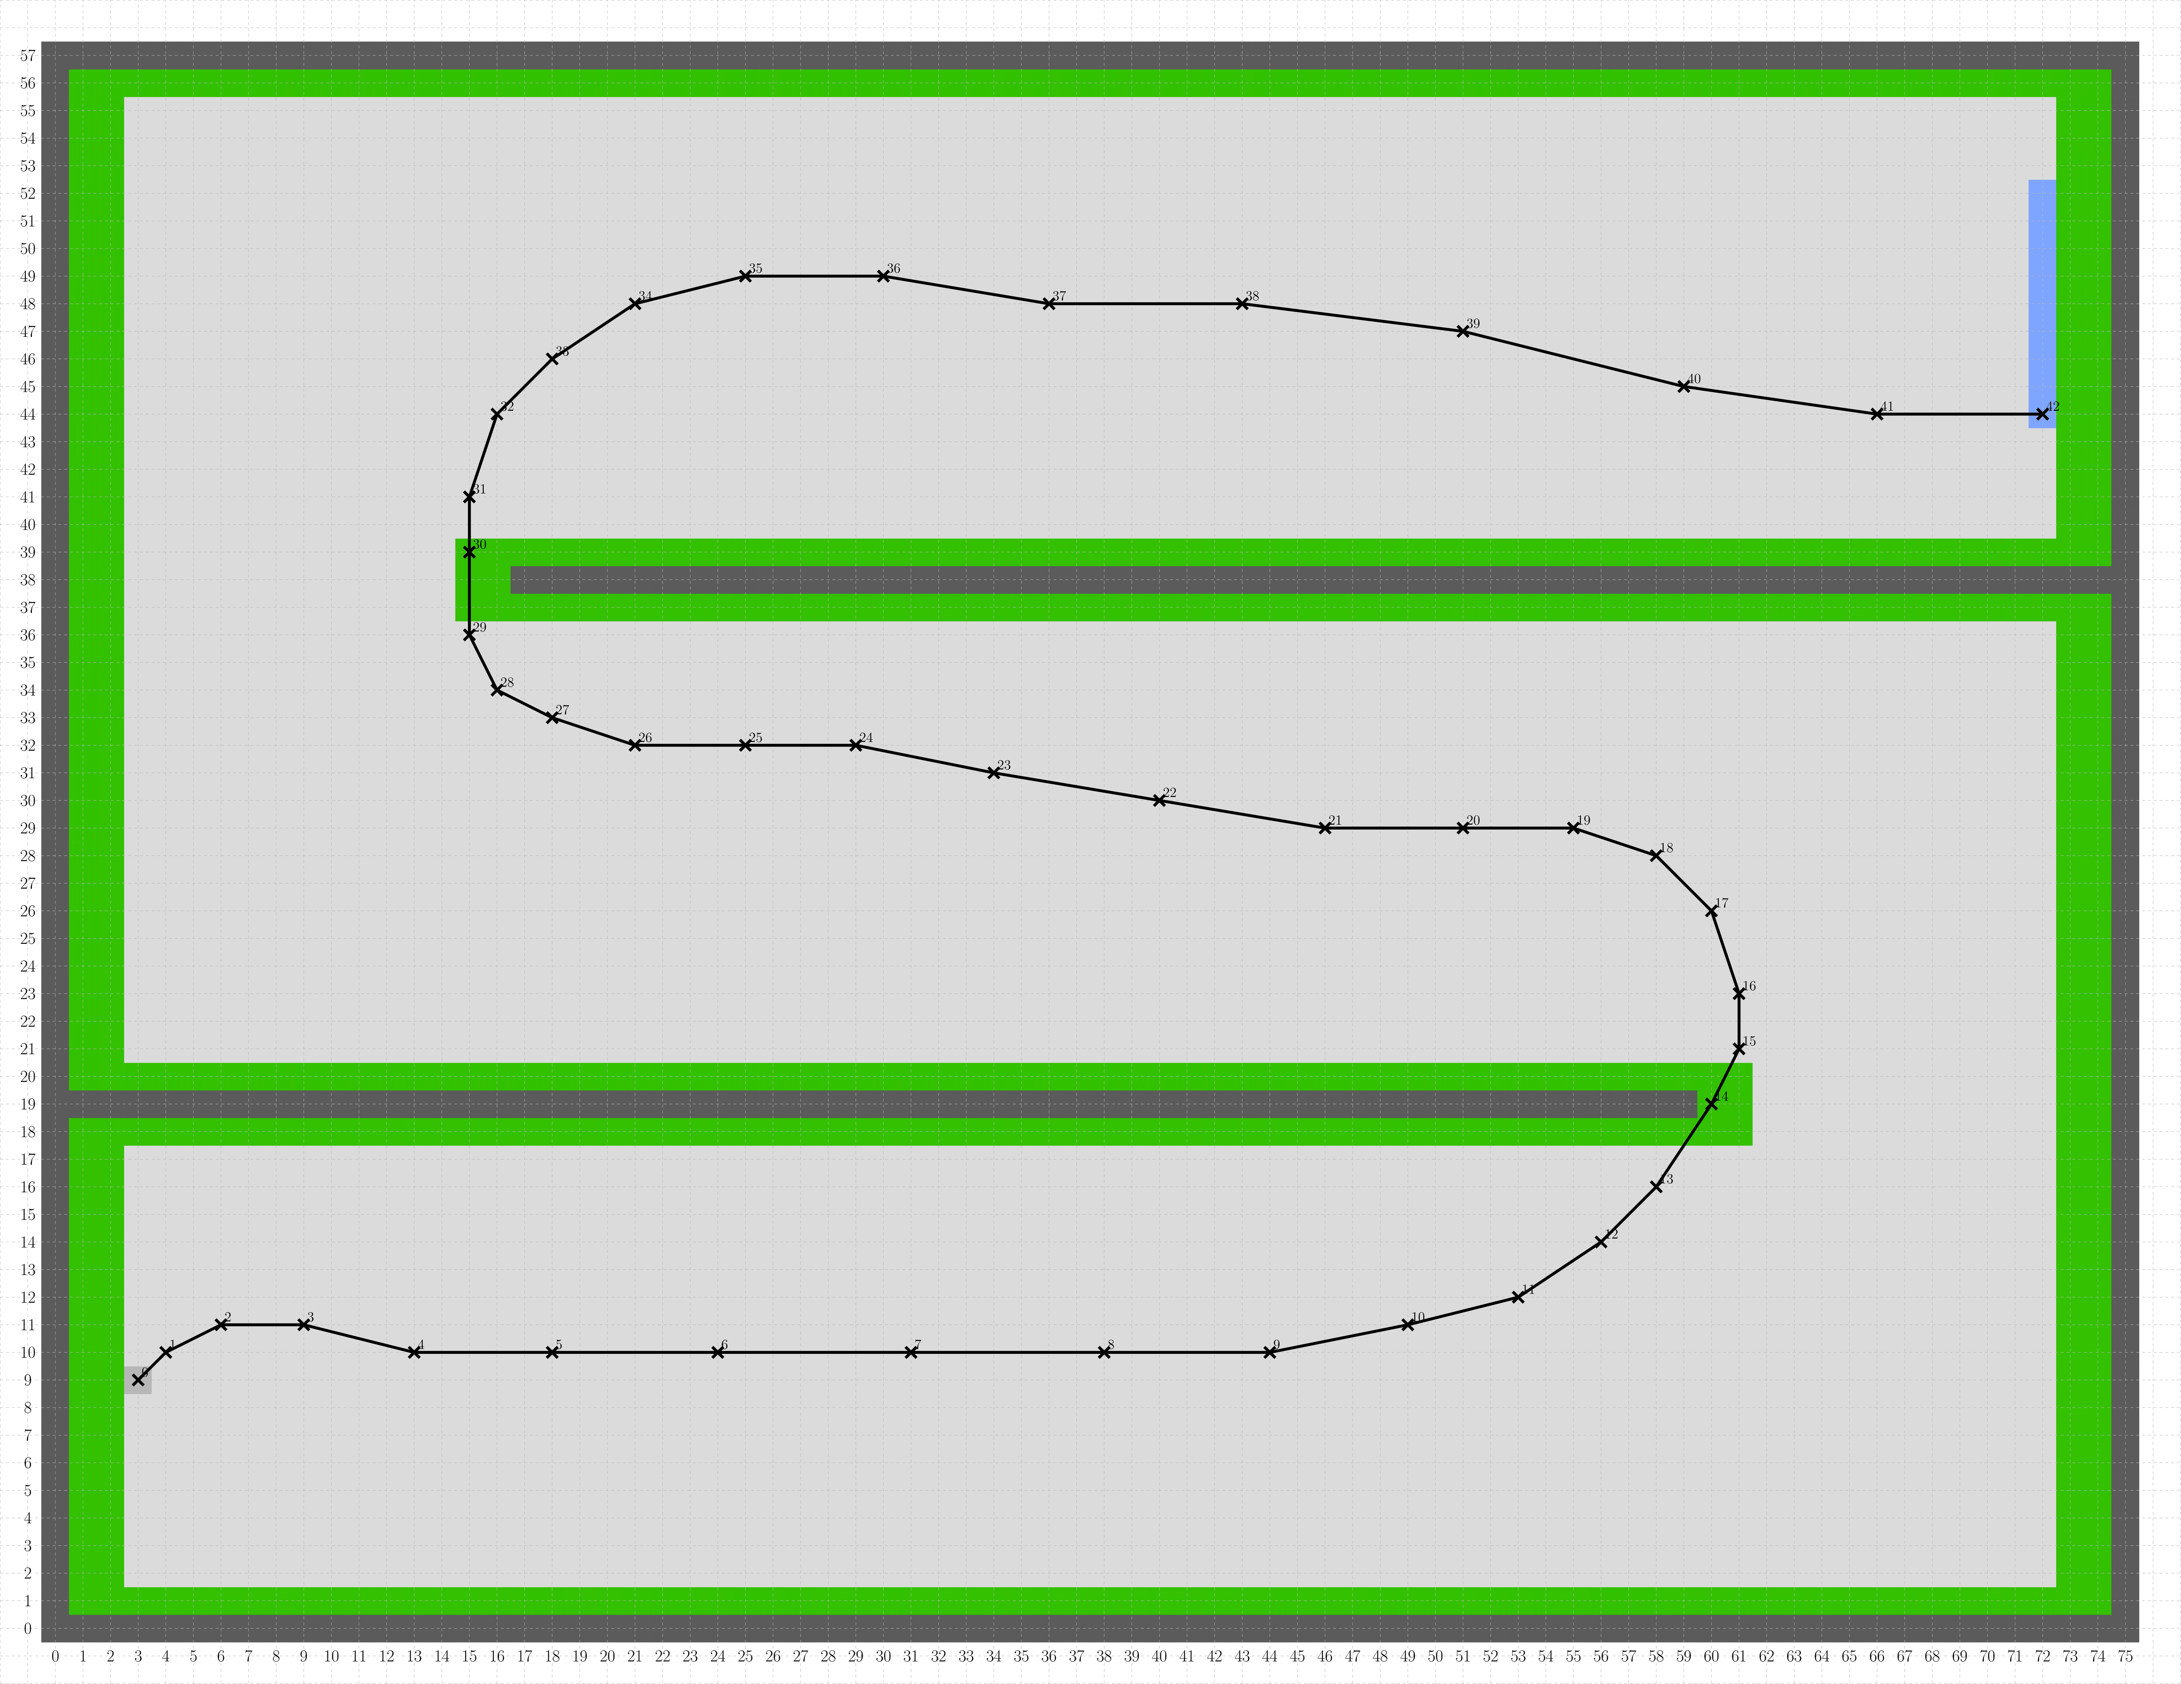
Track 3
Steps | Runtime [s] (average, 5 runs)
42 | 8.89

Slide 11
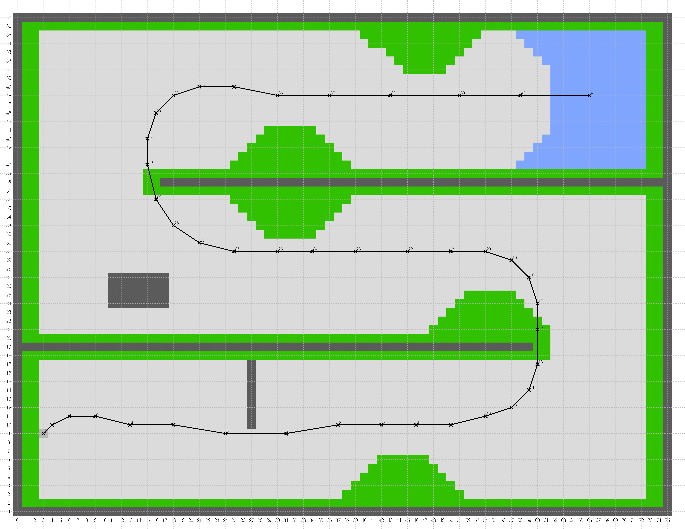
Track 4
Steps | Runtime [s] (average, 5 runs)
41 | 31.50

Slide 12
Track 5
Steps | Runtime [s] (average, 5 runs)
91 | 25.13

Slide 13
Track 6
Steps | Runtime [s] (average, 5 runs)
91 | 24.92

Slide 14
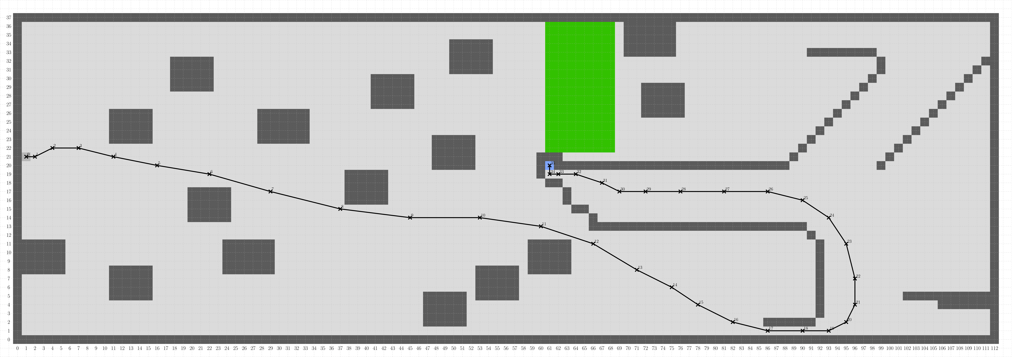
Track 7
Steps | Runtime [s] (average, 5 runs)
35 | 5.44

Slide 15

Track 8
Steps | Runtime [s] (average, 5 runs)
36 | 10.52

Slide 16
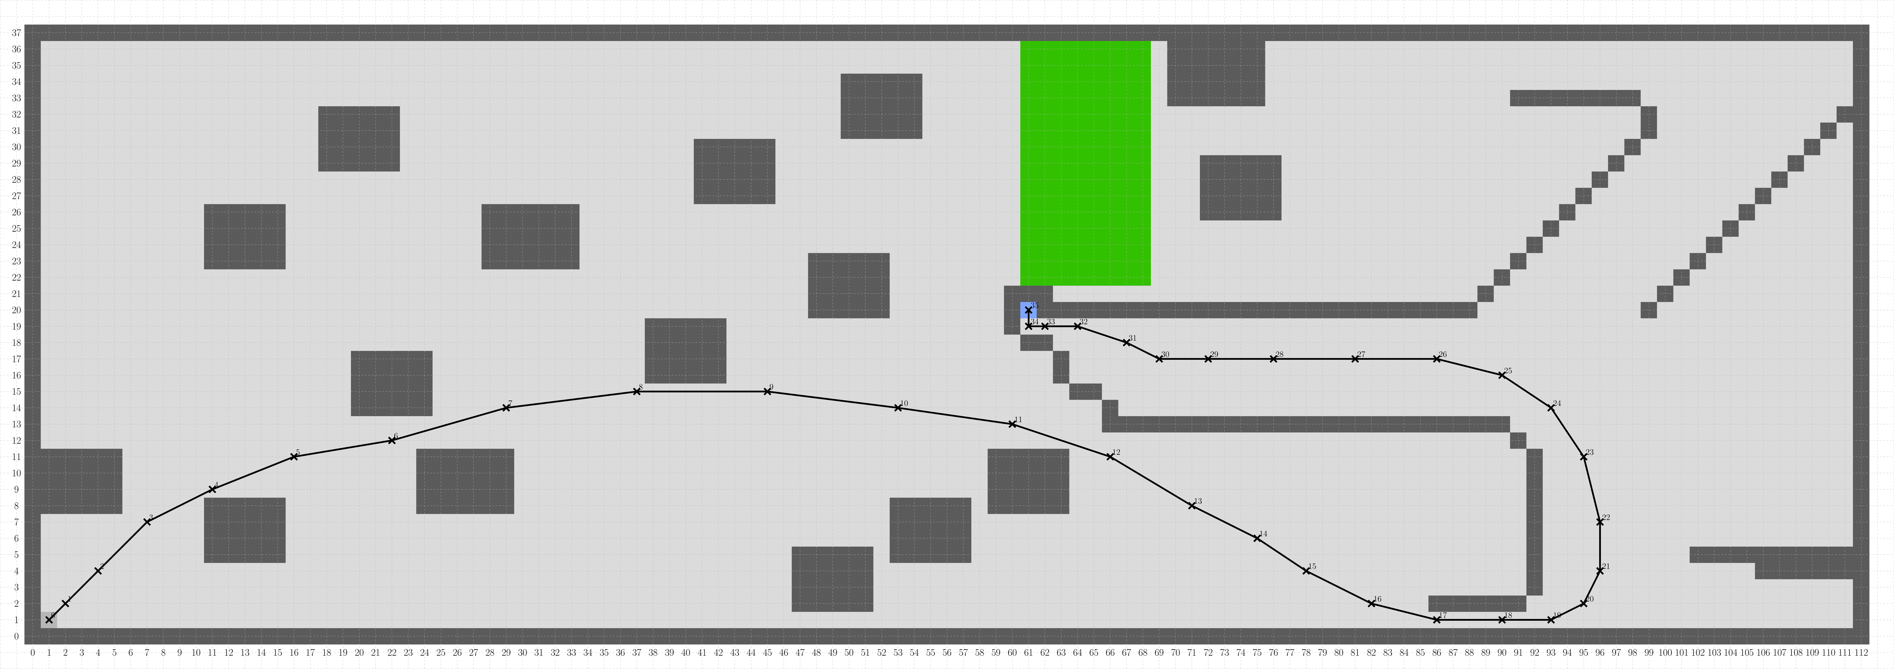
Track 9
Steps | Runtime [s] (average, 5 runs)
35 | 5.02

Slide 17
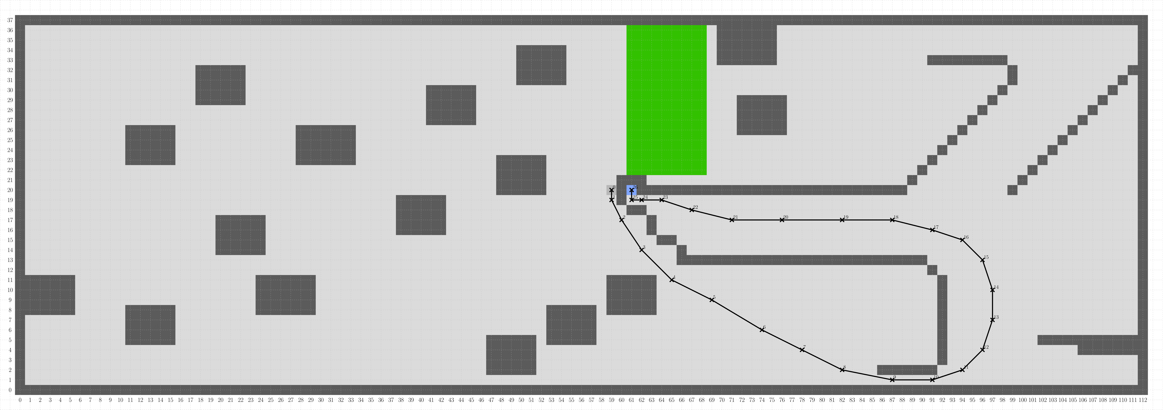
Track 10
Steps | Runtime [s] (average, 5 runs)
26 | 2.73

Slide 18
References
https://playtechs.blogspot.com/2007/03/raytracing-on-grid.html (validation of path line overlapping with objects)

